Slide 1

BLAZE
Forest Fire Method to Sample Very Large Networks for Community Detection
PARVATHY JAYAPRAKASH
METIS 2018

Slide 2
Objective
Understand the implications of Forest Fire Sampling Method on very Large Networks and try to model the dynamics using a MESA model (Blaze)
Notes:
Given a huge real graph, how can we derive a representative sample? There are many known algorithms to compute interesting measures (shortest paths, centrality, betweenness, etc.), but several of them become impractical for large graphs. Thus graph sampling is essential.
The natural questions to ask are (a) which sampling method to use, (b) how small can the sample size be, and (c) how to scale up the measurements of the sample (e.g., the di ameter), to get estimates for the large graph. The deeper, underlying question is subtle: how do we measure success?

Slide 3
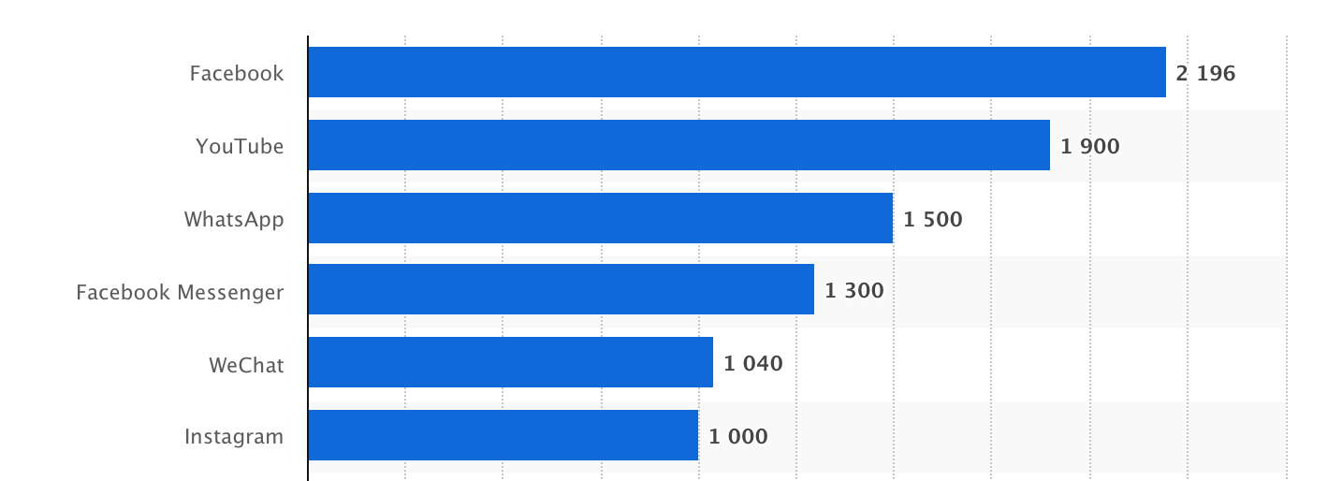
Social Networks ranked by number of active users in millions (as of July 2018)

Slide 4

Why Sample?
Running expensive algorithms on networks with more than a few thousand nodes are prohibitively expensive

Slide 5
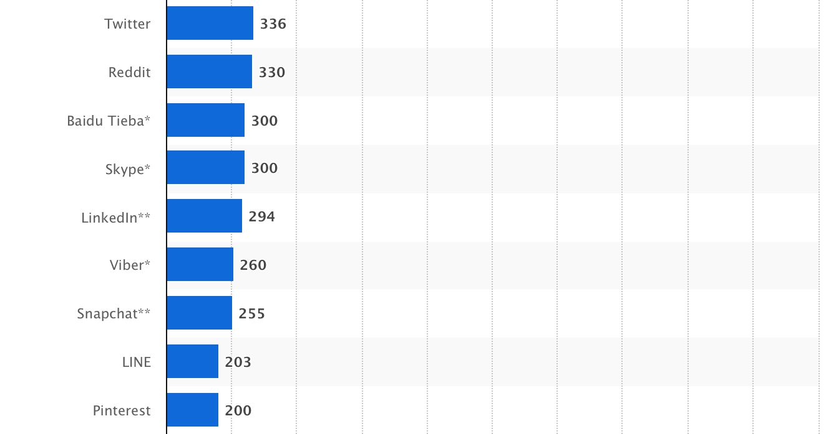
Social Networks ranked by number of active users in millions (...contd)

Slide 6

About Pinterest
Pinterest is a content curation website for sharing pictures and video
‘pin’ images onto boards to categorise them,
‘like’ images to express interest without categorization
Follow other users
Users can :
Notes:
Social content curation is a new trend which has emerged following on the heels of the information glut created by the user-generated content revolution. Rather than create new content, content curation websites allow their users to categorise and organise collections of content created by others that they find online. These users or content curators provide an editorial perspective by highlighting interesting content. Typically, a social component is also involved: users can fol-ow other content curators that they find interesting, as a way of gaining exposure to new and interesting content.

Slide 7


Slide 8
PINTEREST USER NETWORK
USERS | 8,452,977
RELATIONSHIPS | 96,390,143
Dataset Source:
“Sharing the Loves: Understanding the How and Why of Online Content Curation” Zhong, Changtao and Shah, Sunil and Sundaravadivelan, Karthik and Sastry, Nishanth, July 2013, 7th International AAAI Conference on Weblogs and Social Media (ICWSM13)
“

Slide 9
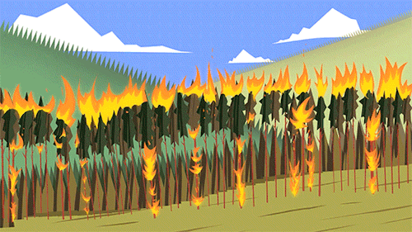
Forest Fire Sampling Algorithm
Choose Node v uniformly at random
Node v selects x outlinks incident to nodes that were not yet visited
Check if Node v should be burned using the forward burning probability parameter
This step is recursively applied until a specified number of nodes have been burned
Nodes cannot be visited a second time, preventing the construction from cycling

Slide 10
Sampling Results
Sampling Method | Forest Fire
Network Traversal | Breadth First Search
Max number of Followers | 20
Sample Size ( Number of records) | 51
 | Dataset | Sample
USERS | 8,452,977 | 2794
RELATIONSHIPS | 96,390,143 | 2951

Slide 11
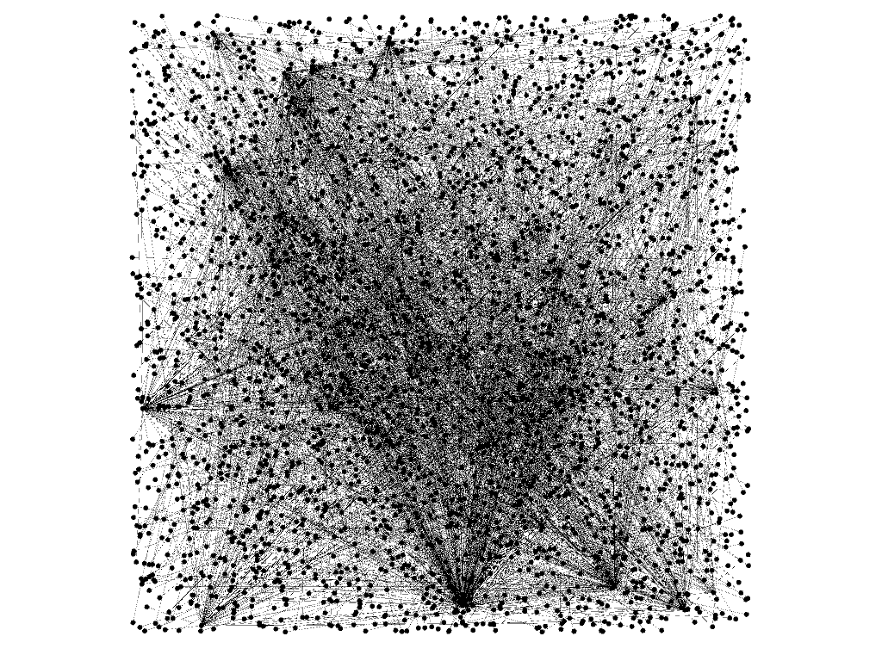
What the sample looks like
Expansion Layout
Scale Factor : 2.5
Generated using Gephi

Slide 12
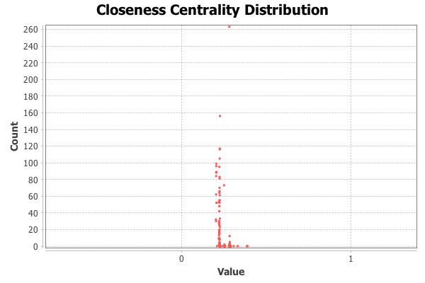
Closeness Centrality
Average distance from a given starting node to all other nodes in the network
Avg. Path Length | 4.51
Average Degree | 2.112
Generated using Gephi

Slide 13
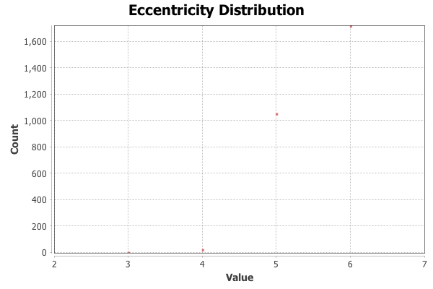
Eccentricity Distribution
The distance from a given starting node to the farthest node from it in the network
Avg. Path Length | 4.51
Generated using Gephi

Slide 14
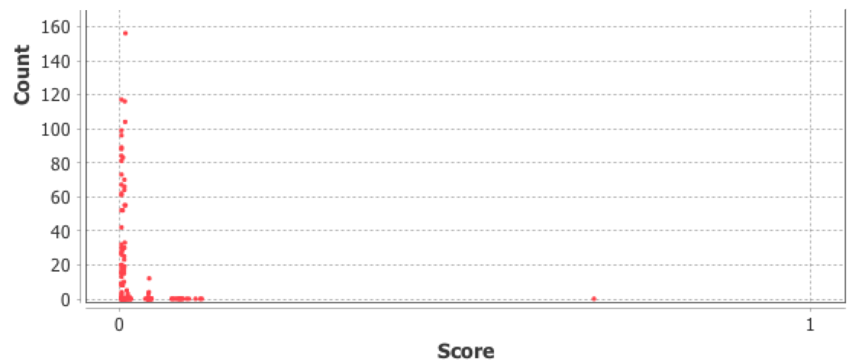
Authority
Distribution
Authority measures how valuable information stored at a particular node is
Stopping criterion (Epsilon) | 1.0e-4
Generated using Gephi

Slide 15
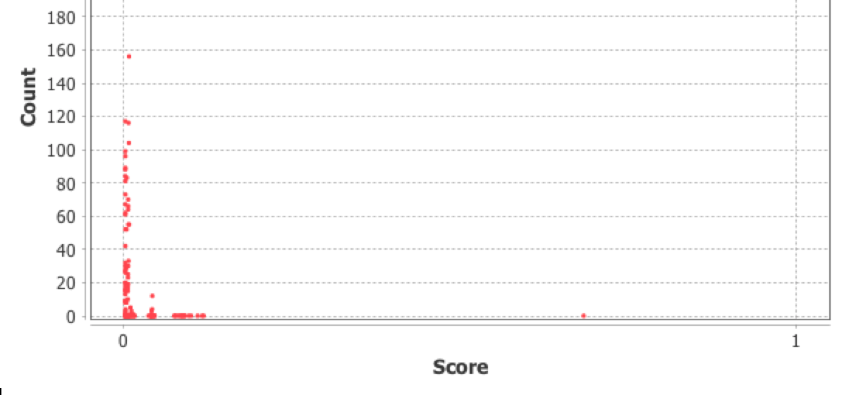
Hub
Distribution
Hub measures the quality of node links
Stopping criterion (Epsilon) | 1.0e-4
Generated using Gephi

Slide 16
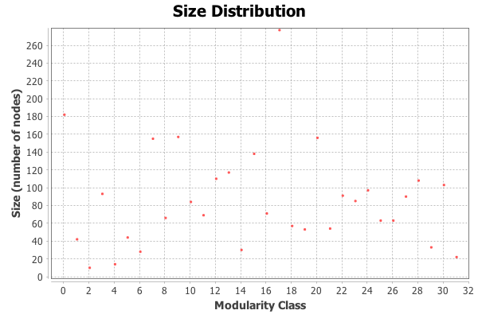
Community Detection
Community Detection in Gephi implements the Modularity Algorithm
Modularity | 0.911
Communities | 32
Generated using Gephi
Notes:
Modularity algorithm implemented in Gephi looks for the nodes that are more densely connected together than to the rest of the network
To make this information really helpful, though, you have to juxtapose it at with at least one more measure. For instance, if you apply Betweenness Centrality measure (which shows which routers are connect the most different communities together or the most influential nodes in the network that serve as the junctions), you'd be able to identify the most vulnerable routers in every community, which should be monitored more closely. You could also filter out a community and identify the most connected routers within each community (highest degree measure), which would then show you which routers are important for that specific community.
All in all, modularity measure allows you to see vulnerable spots of your network and gives you a general idea about its structure.
There is also interesting research on modularity as the measure of network's robustness. For example, if your network has modularity that is too high, it's more robust against random external attacks, but it's also susceptible to targeted attacks on the most connected hubs (high betweenness centrality nodes). On the other hand, if it's too interconnected, you could put it down more easily if you wage a large scale attack on the routers (or if there's a blackout, for example). There's some good explanation of this in the paper (or video / slide show) on information epidemics here and a more general explanation of metastability vs modularity measure here.

Slide 17
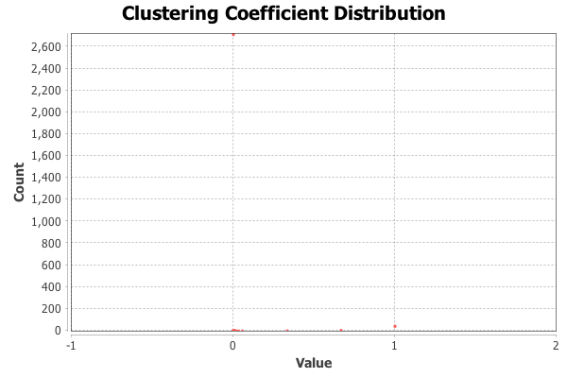
Clustering Coefficient
Indicates how nodes are embedded in their neighborhood
Avg. Clustering Coefficient | 0.326
Total triangles | 67
Generated using Gephi
Notes:
Clustering coefficient -> small world effect
this results in the small world phenomenon of strangers being linked by a short chain of acquaintances.
In particular, a network is said to be a small-world network (or to satisfy the small-world property) if the mean geodesic distance between pairs of nodes is small relative to the total number of nodes in the network—usually, one wants this length ℓ to grow no faster than logarithmically as the number of nodes tends to infinity. That is, ℓ=O(logN) as N→∞. The base of the logarithm doesn't matter.

Slide 18
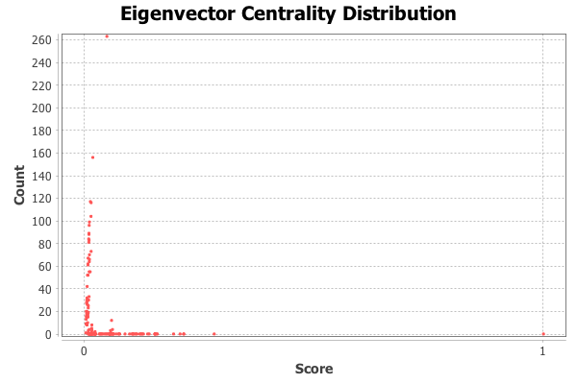
Eigenvector
Centrality
A measure of node importance in a network based on a node’s connections
Generated using Gephi

Slide 19

FOREST FIRE GRAPH SAMPLING MODEL
Built using mesa

Slide 20

GOAL FOR THE FUTURE
Build a tool to help sample large networks
incorporate other sampling techniques into the tool

Slide 21




THANK YOU
PARVATHY JAYAPRAKASH (PARU)
parujp
parujp
paru.jayp@gmail.com

